Slide 1

Predicting Pollution with Machine Learning
By Matthew Jones

Slide 2
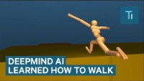


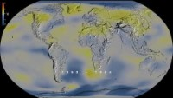
My inspiration for this project
Notes:
Everyday we hear more about how our increased pollution levels are causing global warming.
We also hear about how machine learning is making leaps and bounds in the tech industry, companies such as Google Deep mind are developing deep learning models that can learn to walk and defeat the best humans at logic games like chess
I wanted to figure out if there was a way I could pair these two topics to see if I could find the link between weather and pollution levels using machine learning.

Slide 3
My Goals
Learn
Collect
Create
Learn
Make
Learn how to create a machine learning model
Automatically collect weather and pollution data to train a machine learning model
Create a machine learning model or set of models that takes weather data as an input and outputs predictions for pollution values
Learn web development and use it to create a website to show the results of my project
Make this website user friendly so that someone who does not initially understand the data can come and use it

Slide 4
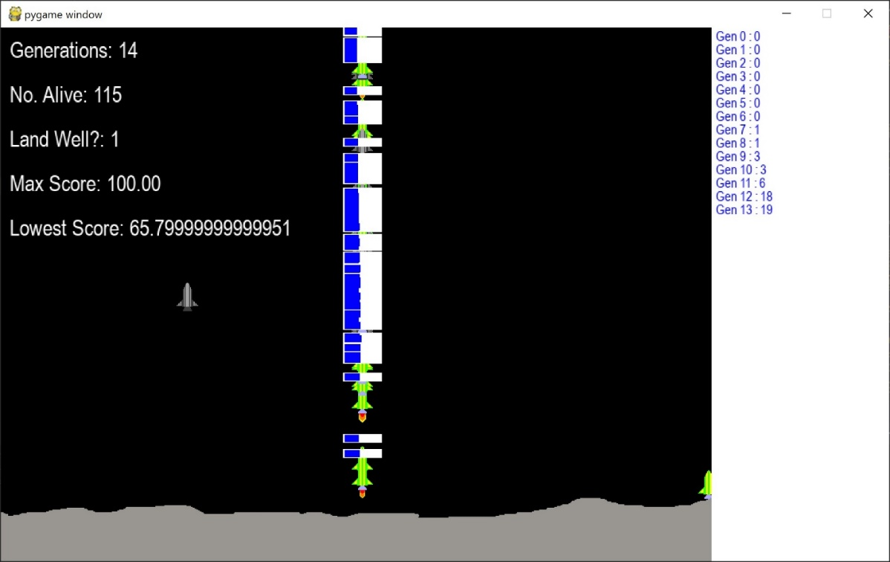
Learning about Machine Learning
“Machine learning is a branch of artificial intelligence (AI) focused on building applications that learn from data and improve their accuracy over time without being programmed to do so.” – IBM Cloud Education
Used the NEAT (Neural Evolution of Augmented Topologies) algorithm to add machine learning to a game I had previously developed to learn some of the intricacies.
Notes:
When I was learning about machine learning I wanted to try a smaller project beforehand, I have included my research on this in the appendices of my project.
This smaller project was to add machine learning to a game I had previously developed in the programming language Python.

Slide 5
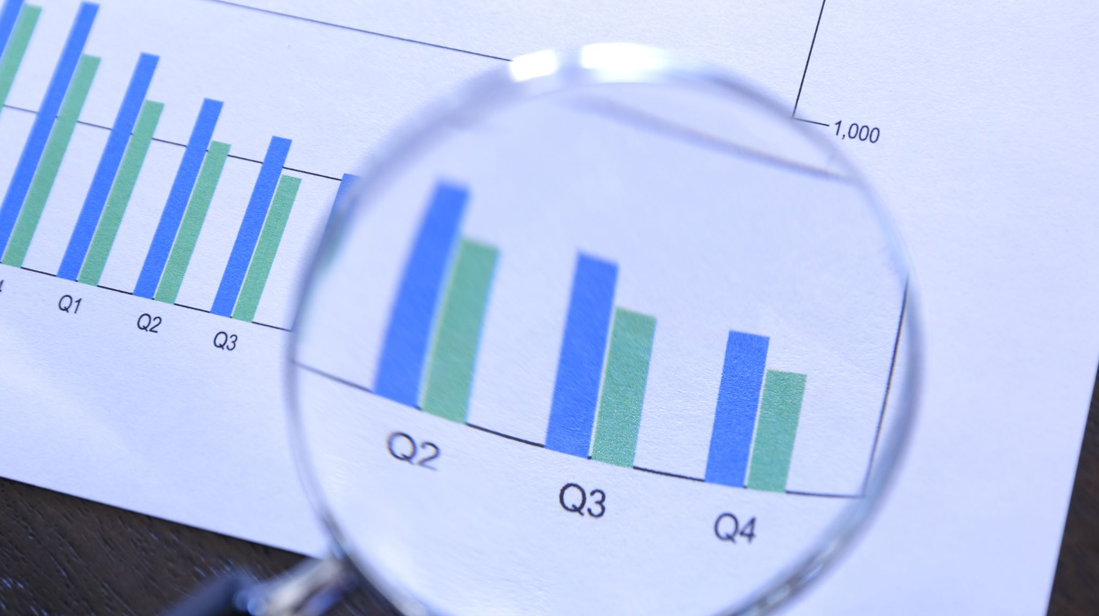
Data

Slide 6


Data Collection
Machine Learning requires data to create a model
My sources of data are the Met Office and London Air by Imperial College London
This data is collected automatically every set time
The data is stored in a remote relational database

Slide 7




Data Processing
Before training the model, the data must be processed
This involved matching pollution and weather locations
This is done using the Haversine formula which is an example of spherical trigonometry
The data for these matched stations are then loaded into memory in the form of tabular data

Slide 8
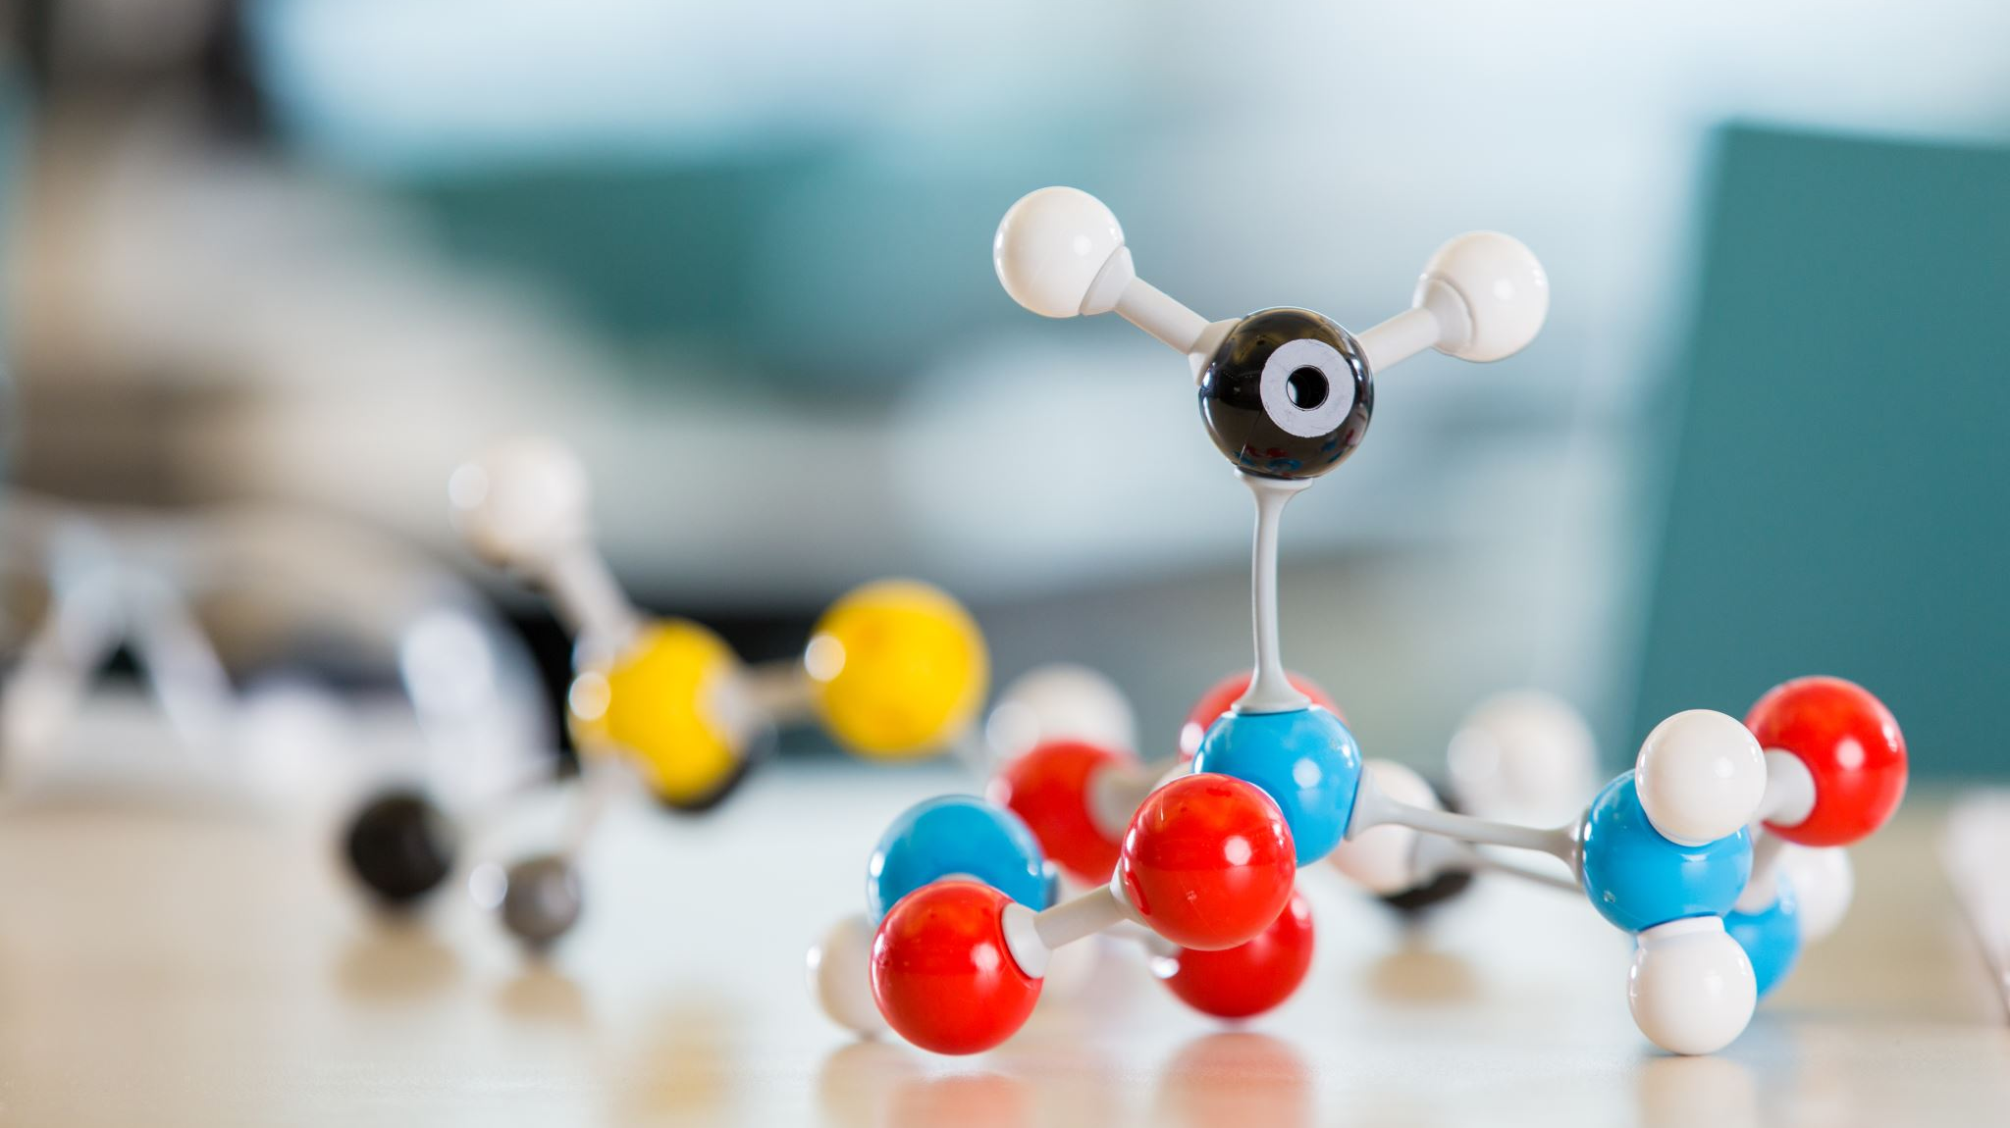
Developing the Models

Slide 9
Model Development
Before training the final model we need to set our Hyperparameters
Hyperparameters are effectively the settings that the model has to achieve the best training possible
Examples of Hyperparameters are the loss function which is used to determine how far the predicted value is from the real value, the activation function of a node which defines the potential outputs of that node.
Hyperparameter tuning: The training algorithm runs multiple simulations with a variety of possible settings to see which one is the most effective

Slide 10
Callbacks
TensorFlow has a feature called callbacks
These are events you can set throughout training based on parameters
ModelCheckpoint callback which saves the model when it improves beyond the last save
ReduceLearningRate callback which lowers the learning rate
Learning Rate: The value that determines how much change will take place in response to estimated error

Slide 11
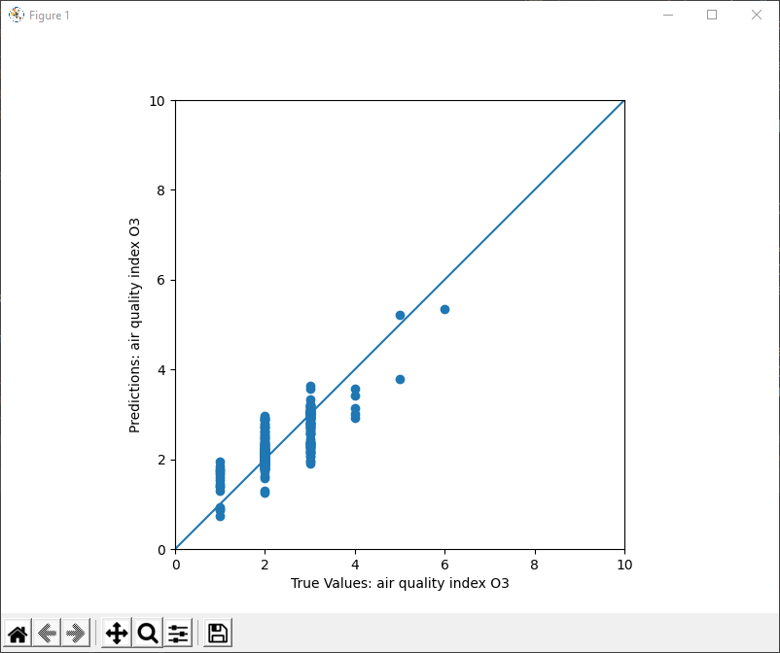
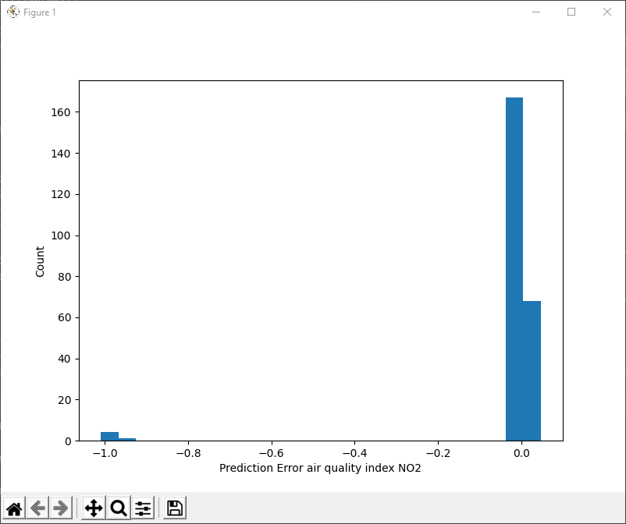
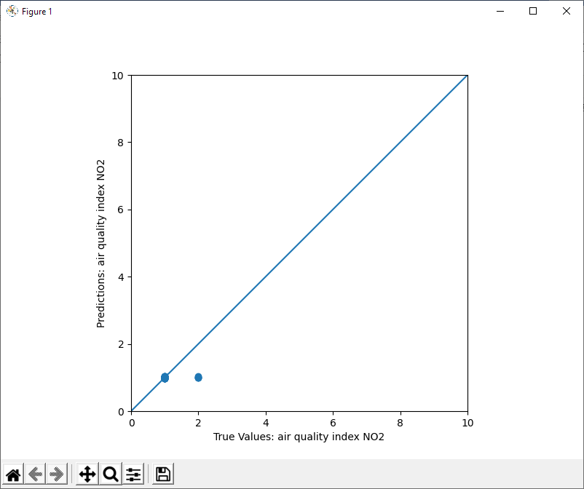
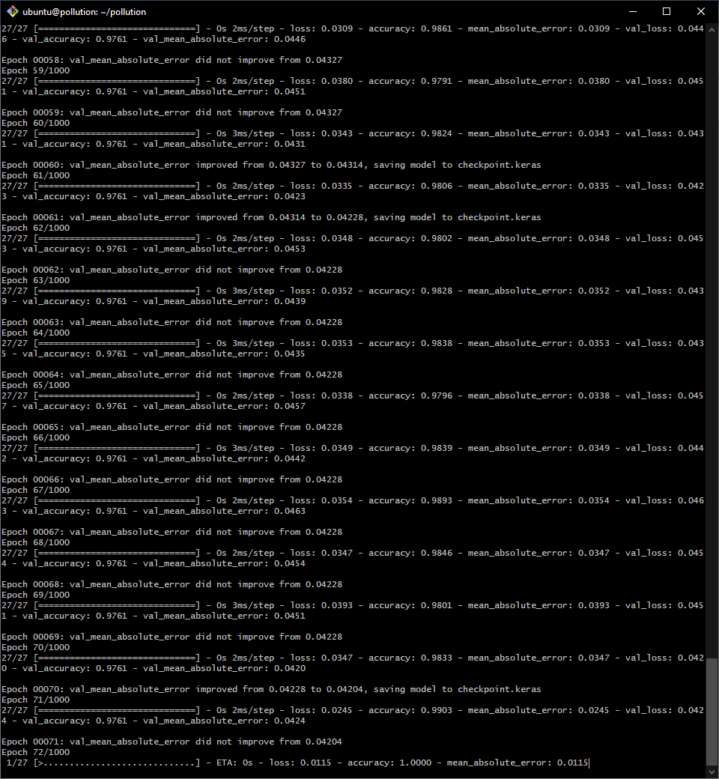
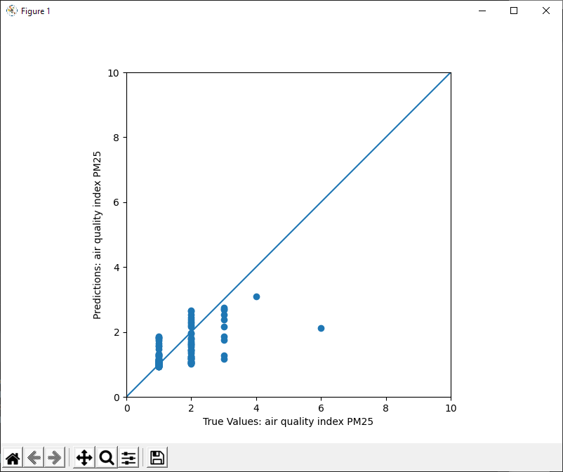
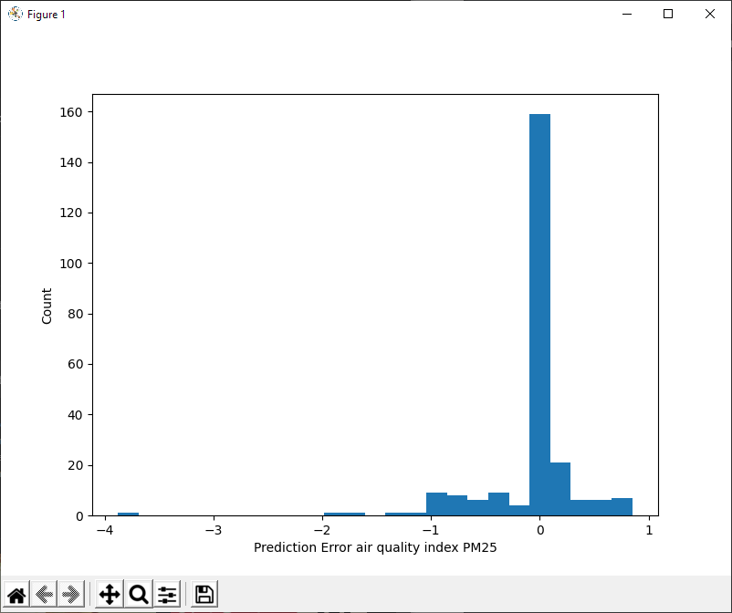
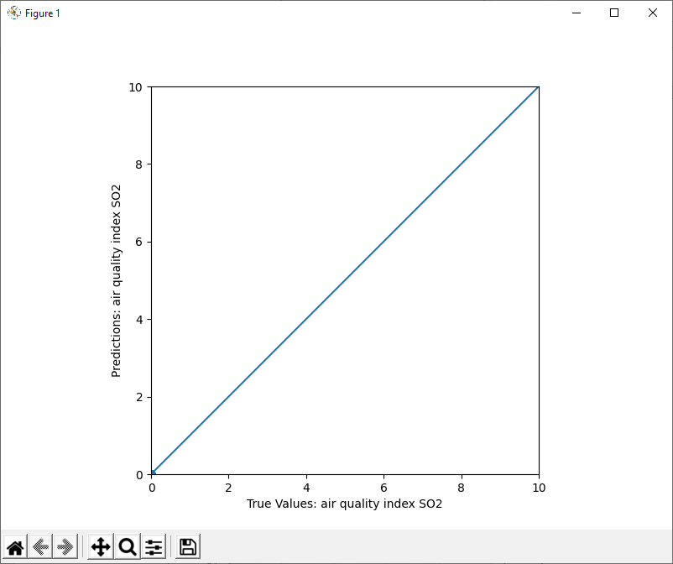
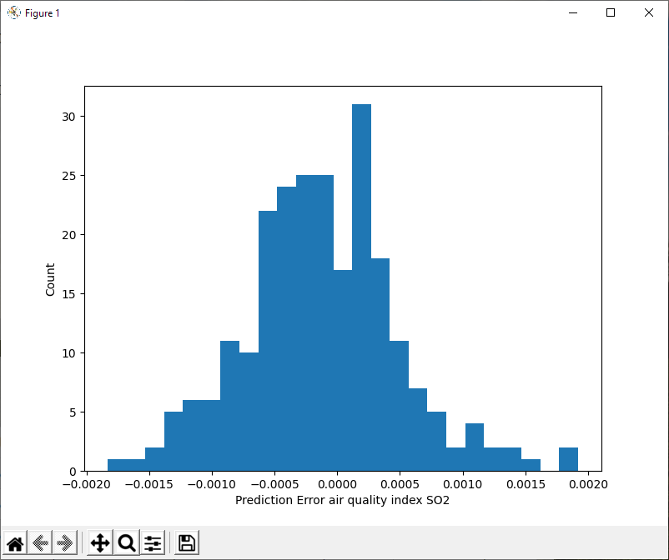
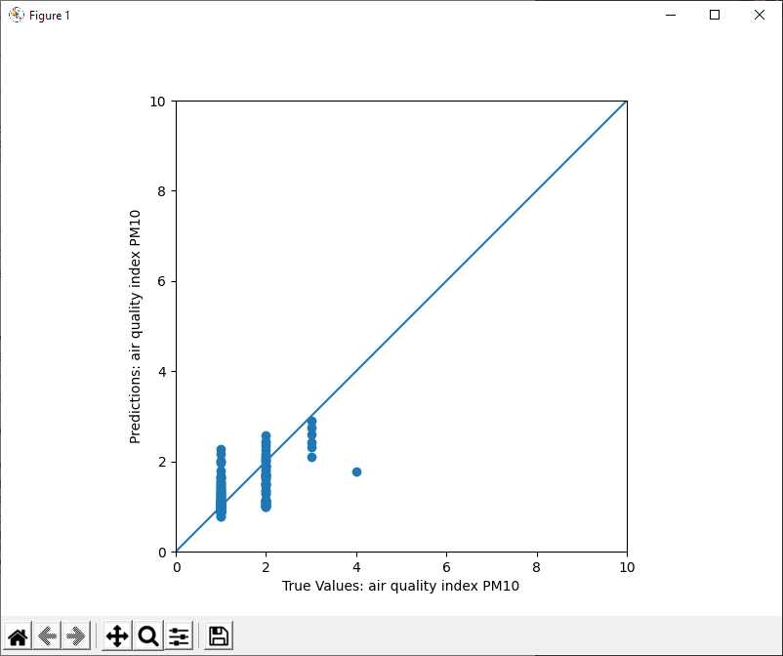
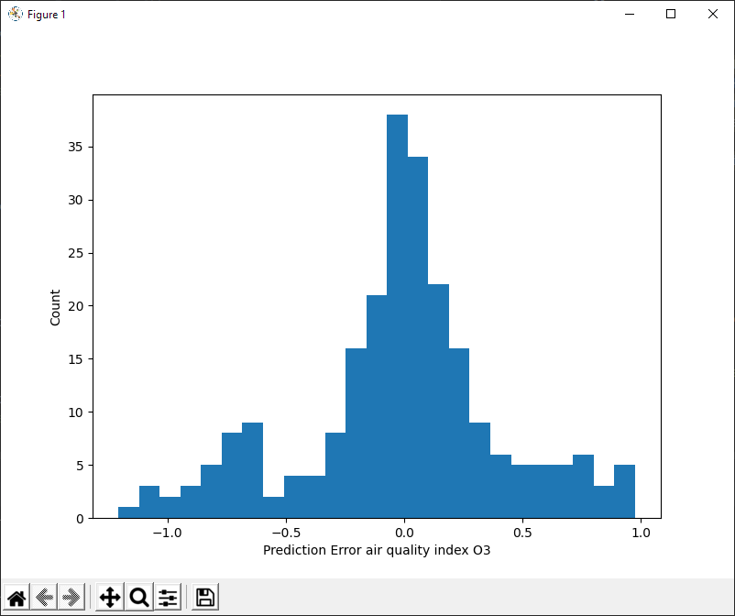
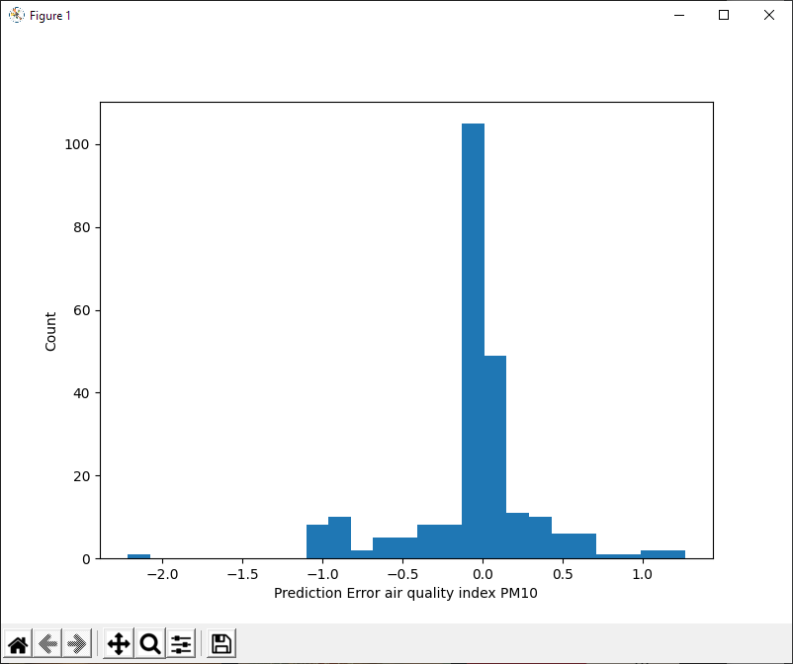
Training

Slide 12

Website Creation

Slide 13
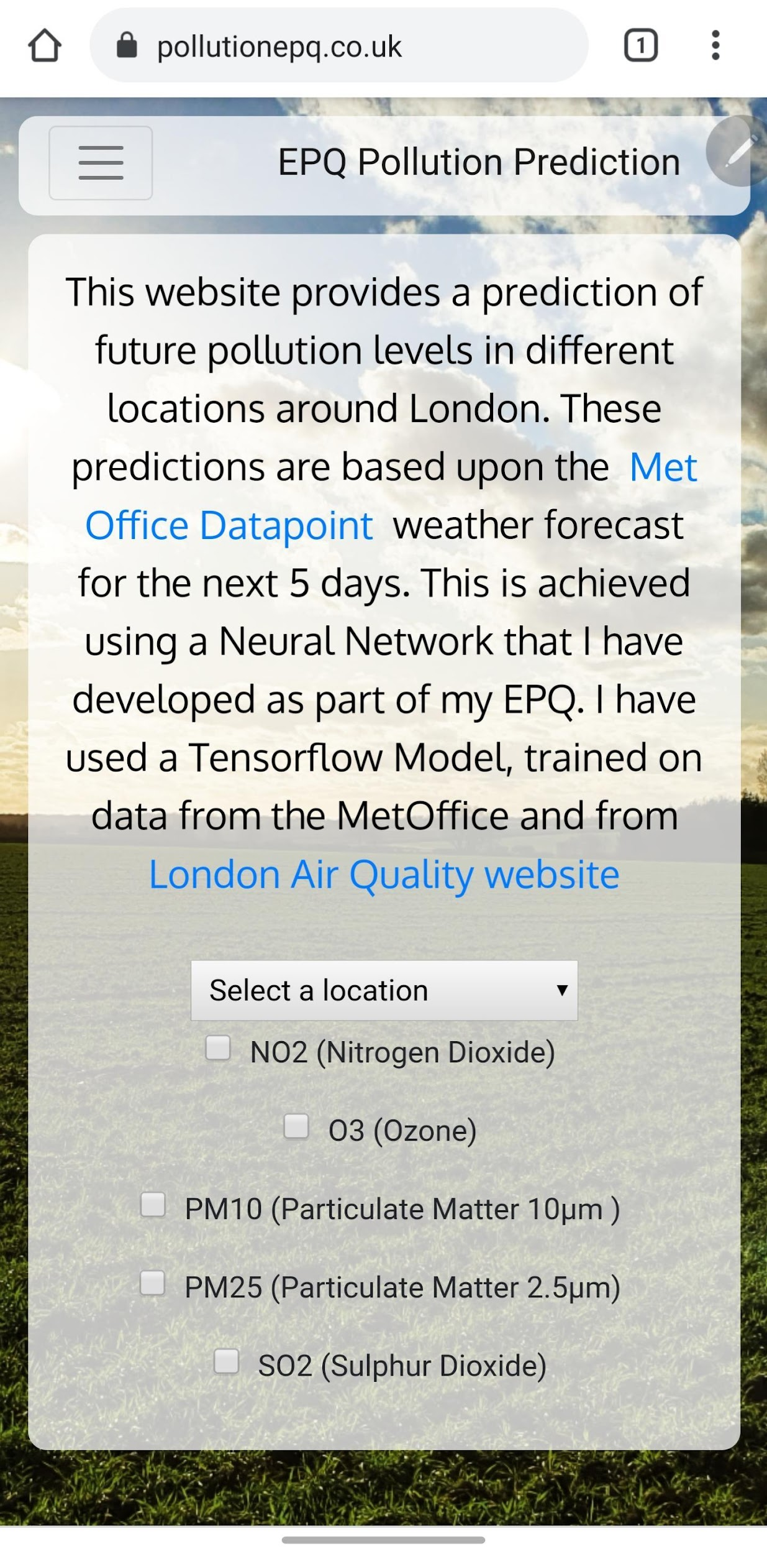
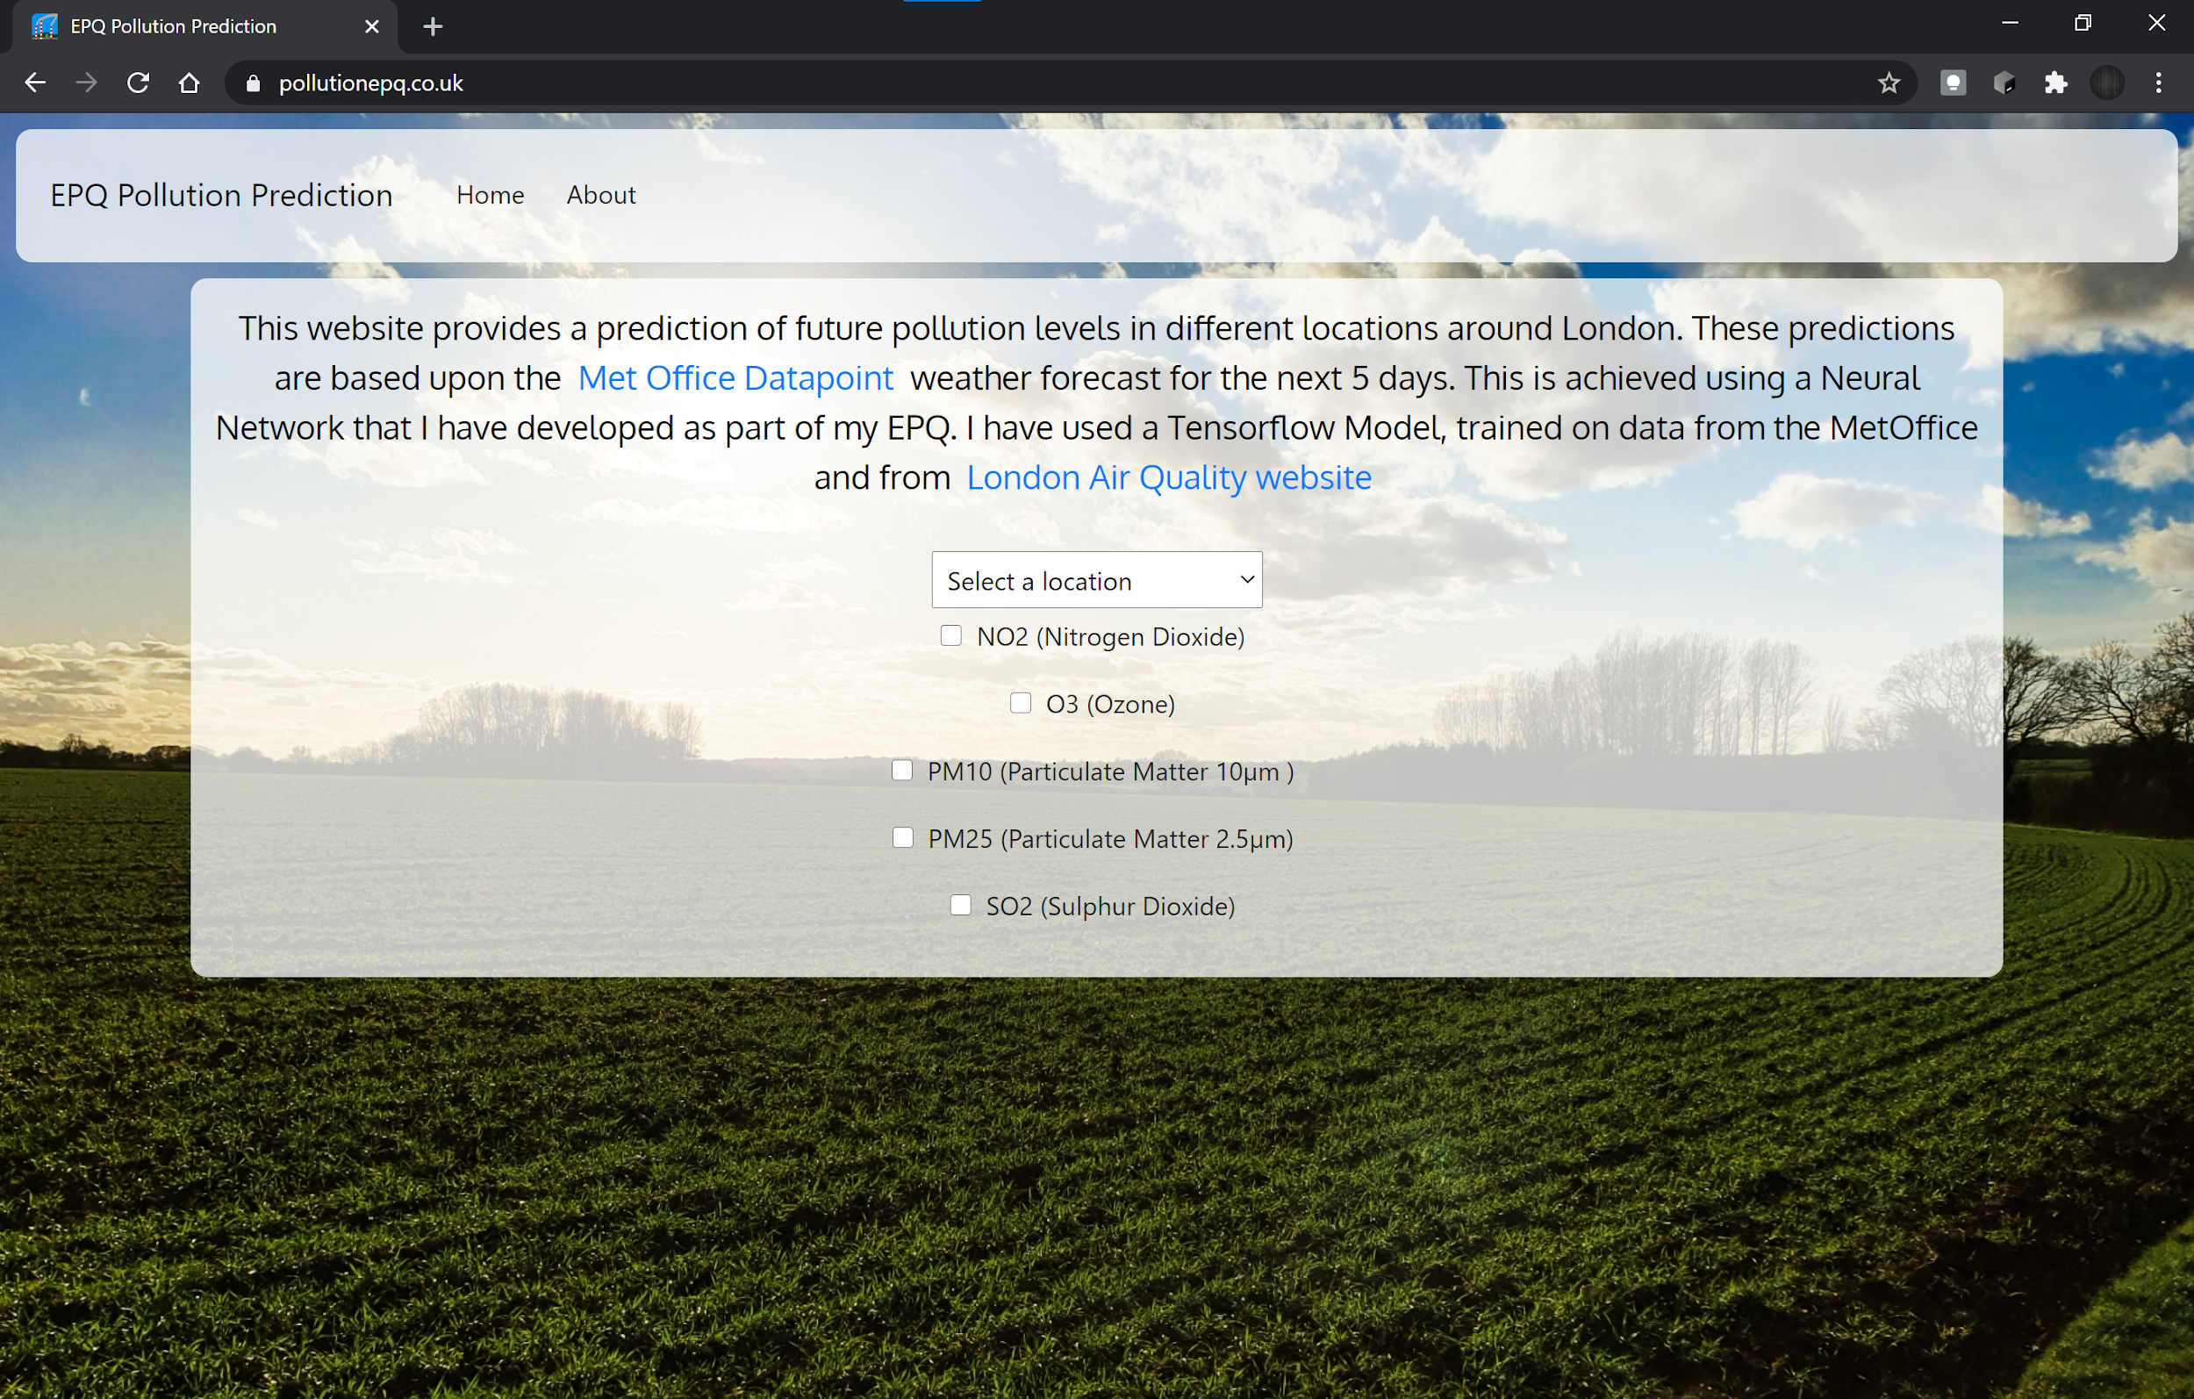
HTML, CSS & Bootstrap
I learnt HTML and CSS through W3schools
Needed to build the website
HTML: HyperText Markup Language
CSS: Cascading Style Sheet
Bootstrap is an HTML/CSS Template Engine
Bootstrap is used to make the website automatically fit to any size screen

Slide 14
jQuery & DataTables
jQuery is a JavaScript library to allow more to be done in less code
jQuery Ajax – Easy web requests to the machine learning model
DataTables is the jQuery plugin for writing HTML tables in JavaScript
Used to display the model output

Slide 15
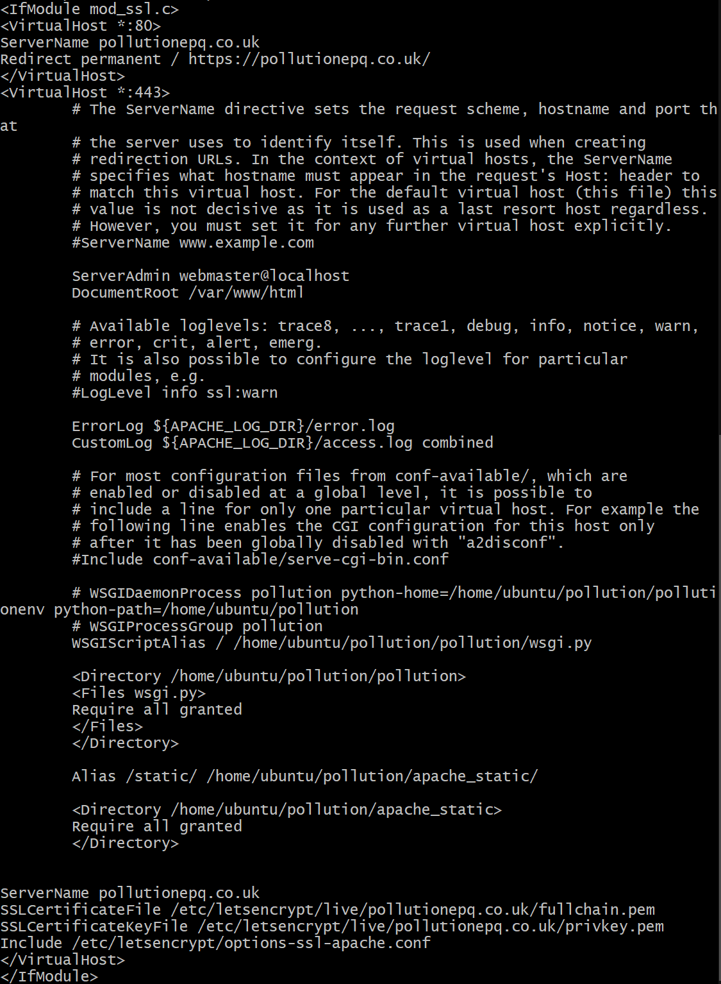
Apache + mod_wsgi
Deployment of Django Application
Using domain name from Google Domains
Static files to serve images and JavaScript
SSL
SSL encrypts the communication between the browser and the server
Inspires trust in the website
Added in Apache settings

Slide 16
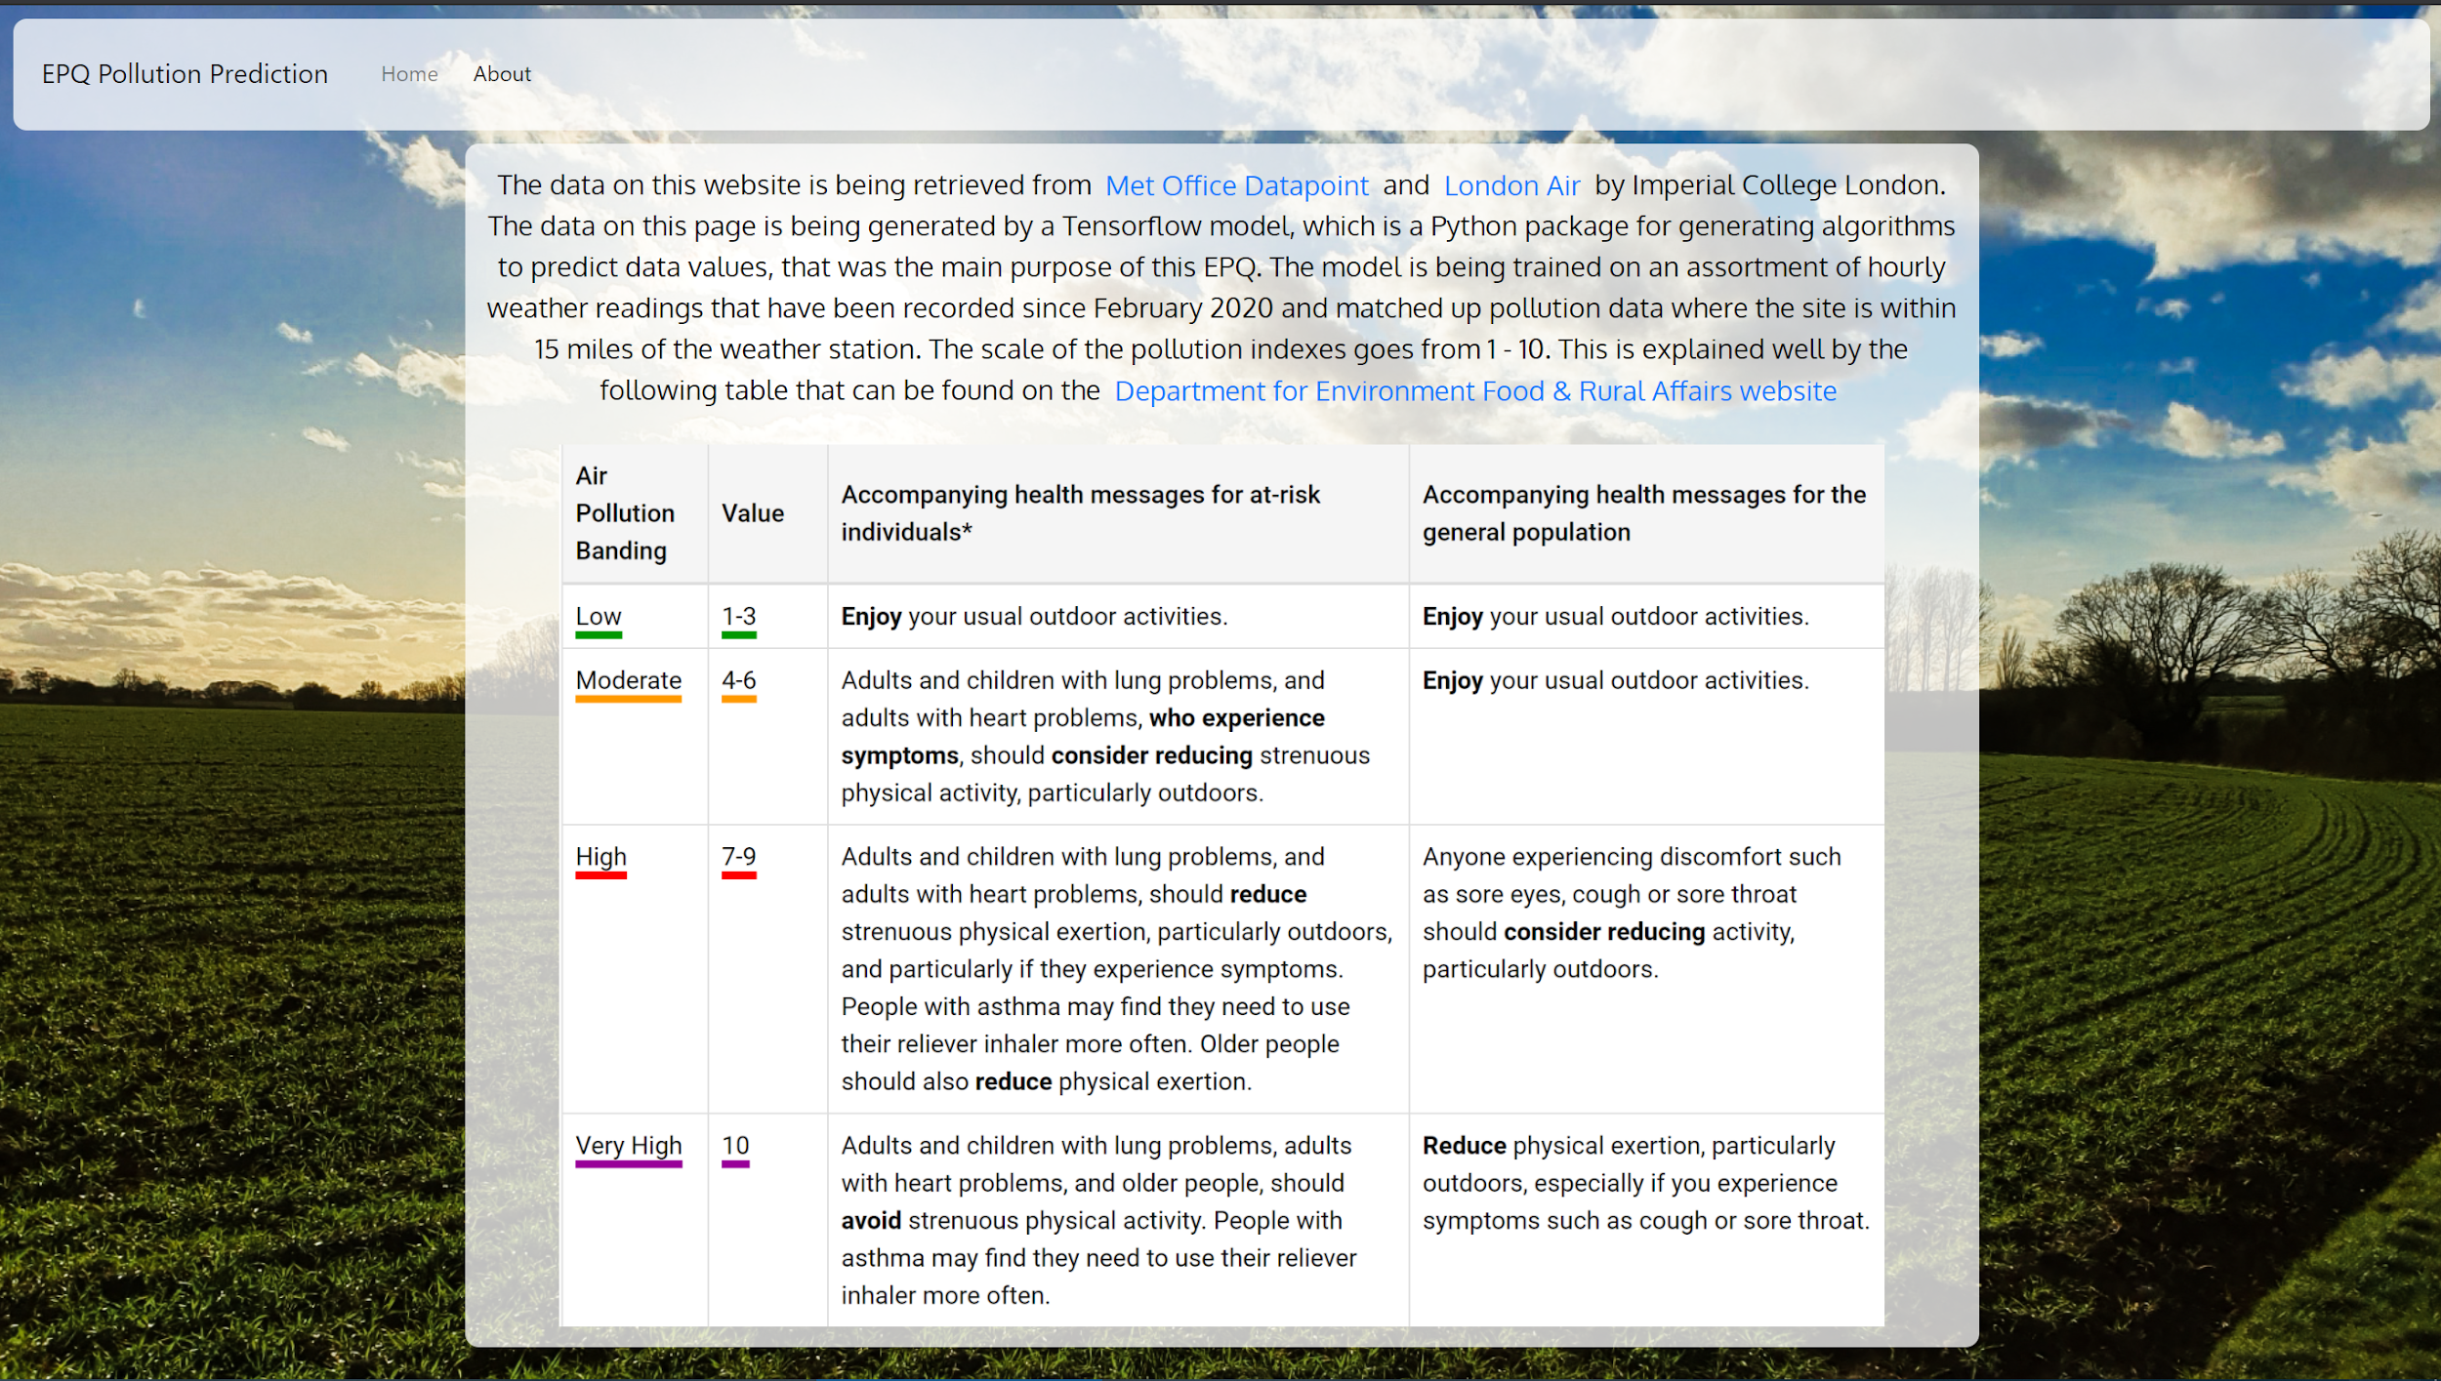
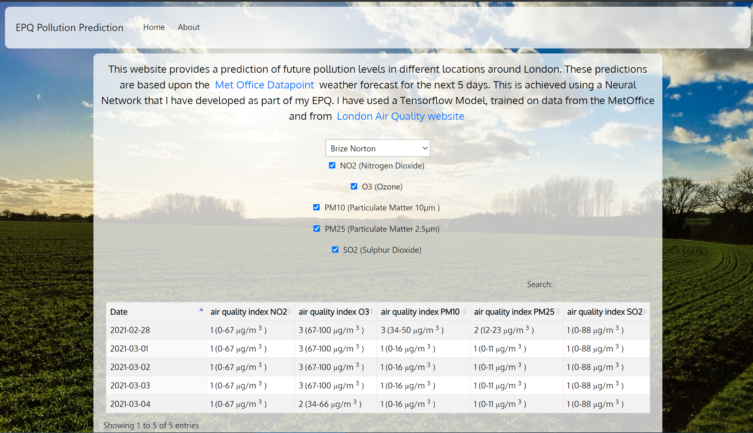
Final Outcome

Slide 17



What went well?
ALL MY INITIAL GOALS WHERE ACCOMPLISHED
LEARNT 2 NEW BRANCHES OF SOFTWARE DEVELOPMENT
LEARNT HOW TO CONFIGURE A LINUX INSTALLATION FOR A SPECIFIC TASK

Slide 18



What did not go well?
My time management could be improved
I ran into multiple issues when writing my code such as the model not training at all.
I fell behind on my project over the Year 12 🡪 13 summer holiday
Underestimated how long it would take to collect enough data to create an effective model

